Slide 1
Lecture 3
Chapter 3
A top-level view of Computer Function and Interconnection

Slide 2
Key Points
Instruction cycle consists of an instruction fetch, followed by zero or more operand fetches, followed by zero or more operand stores, followed by an interrupt check (if interrupts are enabled)
Major computer system components (processor, main memory, I/O modules) need to be interconnected in order to exchange data and control signals.
The most popular means of interconnection is the use of a shared system bus consisting of multiple lines. In contemporary systems, there typically is a hierarchy of buses to improve performance.

Slide 3
Concepts
Computer consists of CPU, memory and I/O components, with one or more modules of each type
These components are interconnected in some way to achieve the basic function of the computer, which is to execute programs

Slide 4
Computer Design
All contemporary computer designs are based on concepts developed by John von Neumann at the Institute for Advanced Studies, Princeton U.
Such a design is referred to as the von Neumann architecture and based on 3 concepts:
  Data and instructions are stored in a single read-write memory
  The contents of this memory are addressable by location, without regard to type of data contained there
  Execution occurs in a sequential fashion from one instruction to the next.

Slide 5
Computer Components and Control Program
The basic logic components are connected in various ways to store binary data and to perform arithmetic and logical operations on that data. The resulting “program” is in the form of hardware and is termed a hardwired program.
    The system accepts data and produces results
    Hardwired systems are inflexible
General purpose hardware for arithmetic and logic functions can do different tasks, depending on control signals applied to the hardware system
    The system accepts data and control signals and produces results
    Instead of re-wiring, all we need is to supply a new set of control signals

Slide 6
How shall the control signal be supplied?
The entire program is a sequence of steps, at each step some arithmetic or logical operation is performed on some data
For each operation a unique code is provided
  e.g. ADD, MOVE
A hardware segment accepts the code and issues the control signals

Slide 7
Program Concept:
Hardware and Software approaches
Sequence of Arithmetic and Logic Functions
Data
Results
Programming in Hardware
Instruction Codes
Instruction Interpreter
Control Signals
General-Purpose Arithmetic and logic Functions
Data
Results
Programming in Software

Slide 8
What is software?
Instead of rewiring the hardware for each new program, all we need to do is provide a new sequence of codes.
Each code is, in effect, an instruction, and part of the hardware interprets each instruction and generates control signals.
A sequence of codes or instructions is called software

Slide 9
Components of computer
The Control Unit and the Arithmetic and Logic Unit constitute the Central Processing Unit
Data and instructions need to get into the system and results out
  Input/output
Temporary storage of code and results is needed
  Main memory
  von Neumann pointed out that the same memory could be used to store both instructions and data

Slide 10
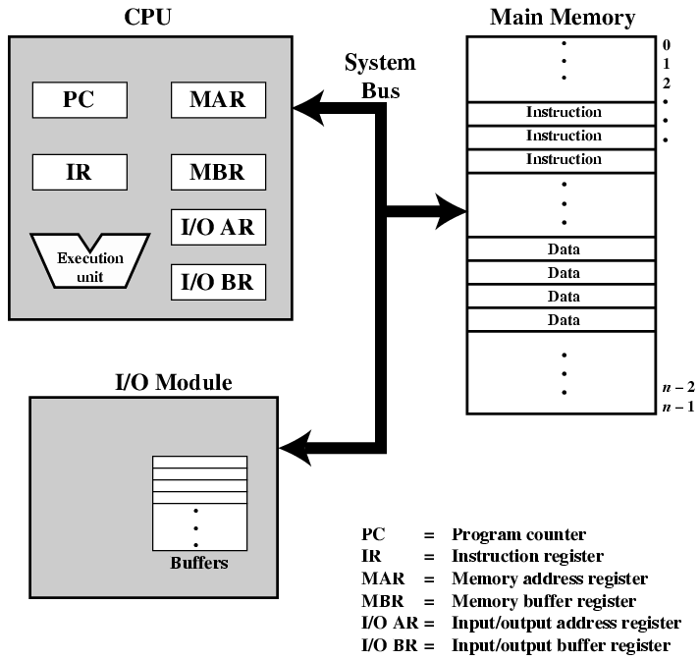
Computer Components:
Top Level View

Slide 11
Computer Components:
Top Level View
CPU exchanges data with memory: typically, it makes the use of two internal (to the CPU) registers:
  (MAR) Memory Address register, which specifies the address in memory for the next read and write , and
  (MBR) Memory Buffer register, which contains the data to be written into memory or receives the data read from memory
(I/OAR) I/O Address Register specifies a particular I/O device
(I/OBR) I/O Buffer Register is used for the exchange of data between an I/O module and the CPU

Slide 12
Computer Components:
Top Level View
Memory module contains a set of locations, defined by sequentially numbered addresses. Each location contains a binary number that can be interpreted as either an instruction or data
I/O module transfers data from external devices to CPU and memory, and vice versa. It contains internal buffers for temporary holding these data until they can be sent on

Slide 13
Computer Function
Basic function performed by a computer is execution of a program, which consists of a set of instructions stored in memory
The processor does the actual work by executing instructions specified in the program
In the simplest form, instruction processing consists of two steps: the processor reads (fetches) instructions from memory one at a time and executes each instruction. Program execution consists of repeating the process of instruction fetch and instruction execution

Slide 14
Computer Function
The processing required for a single instruction is called an instruction cycle
Next figure show the instruction cycle
The two steps are referred to as the fetch cycle and the execute cycle
Program execution halts only if the machine is turned off, some sort of unrecoverable error occurs, or a program instruction that halts the computer is encountered

Slide 15

Instruction Cycle
Two steps:
  Fetch
  Execute

Slide 16
Fetch Cycle
At the beginning of each instruction cycle, the processor fetches an instruction from memory
In typical processor, Program Counter (PC) register holds address of next instruction to be fetched next
Processor fetches instruction from memory location pointed to by PC
Increment PC
  Unless told otherwise
The fetched instruction is loaded into Instruction Register (IR).
The instruction contains bits that specify the action the processor is to take. The processor interprets the instruction and performs required actions. In general, these actions fall into four categories.

Slide 17
Execute Cycle
Processor-memory
  data transfer between CPU and main memory
Processor I/O
  Data transfer between CPU and I/O module
Data processing
  Some arithmetic or logical operation on data
Control
  Alteration of sequence of operations
  e.g. jump
** Obvious, a combination of above is also ** possible

Slide 18
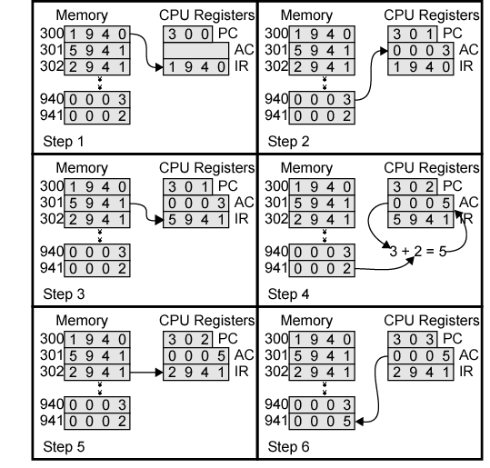
Example of Program Execution

Slide 19
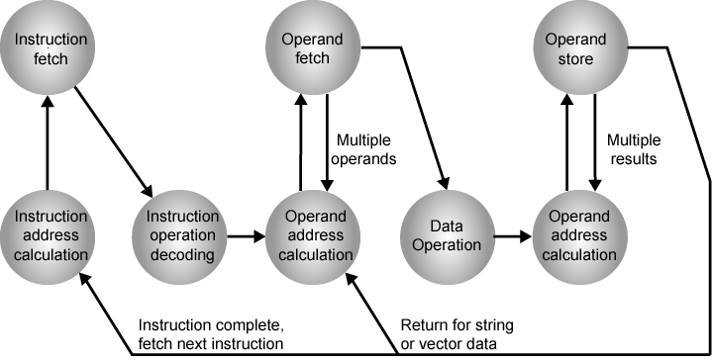
Instruction Cycle State Diagram

Slide 20
Instruction Cycle - State Diagram (2)
Instruction address calculation (iac): determine the address of the next instruction to be executed. Usually, this involves adding a fixed number to the address of the previous instruction.
Instruction fetch (if): read instruction from its memory location into the processor.
Instruction operation decoding (iod): analyze instruction to determine type of operation to be performed and operand(s) to be used.
Operand address calculation (oac): if the operation involves reference to an operand in memory or available via I/O, then determine the address of the operand.

Slide 21
Instruction Cycle - State Diagram (3)
Operand fetch (of): fetch the operand from memory or read it in from I/O
Data operation (do): perform the operation indicated in the instruction
Operand store (os): Write the result into memory or out to I/O

